Slide 1
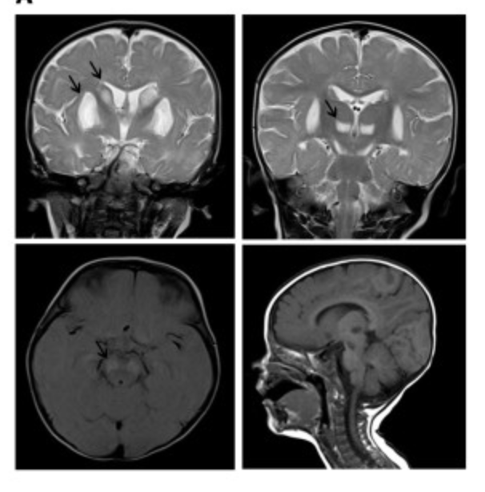
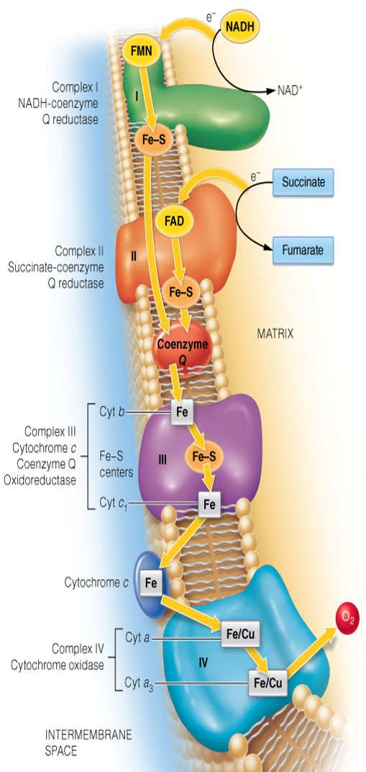
Leigh Syndrome
Sophia Lee & Samone Wilson
Calvin College, Grand Rapids, Michigan
Disease Summary
Scientific Background
Treatment Strategies
Leigh syndrome is a severe neurological disorder characterized by progressive loss of mental and movement abilities. It usually becomes apparent during infancy, and common symptoms include problems with movement and balance, difficulty in talking and weak muscle tone. It affects about 1 in 40,000 newborns.
Various gene mutations can lead to Leigh syndrome, most of which are involved with energy production in the mitochondria.
There is no definitive treatment to prevent or cure Leigh syndrome, but there are a couple of tentative treatments administered to slow the progression of the disease.
Genetic Variation
Mutations found in over 75 genes
Genes associated with production or assembly of the electron transport chain
Common genes include SURF1, LRPPRC, BCS1L and NDUFAF2
Impact on Energy Generation
Mutations lead to reduction or elimination of activity of one or more of these protein complexes
Impaired energy production leads to cell death. Certain tissues such as the brain, muscles and heart cells are especially sensitive to decreases in cellular energy.
References
Biochemistry: Concepts and Connections, Appling
Gene Reviews: Nuclear Gene-Encoded Leigh Syndrome Overview
NIH Genetics Home Reference
Common treatment is administration of thiamine (Vitamin B1) or thiamine derivatives. Some people experience slight slowing of the progression of the syndrome with thiamine treatment.
Patients with a deficiency of pyruvate dehydrogenase enzyme complex are recommended a high fat, low carbohydrate diet .
In FDA Expanded Access protocol, children may be treated with EPI-743, showing signs of neurologic and neuromuscular improvement
Leigh Syndrome often leads to lesions forming on the brain
Recent Advances
Resources
Clinical Trials
There is an ongoing clinical trial for Leigh syndrome observing the long-term effects and safety of a drug called EPI-743 in children with Leigh syndrome (estimated to conclude April 2018 ).
A clinical trial is currently recruiting patients with Leigh syndrome to further understand disease characteristics.
Signs and Symptoms
First signs usually seen during the first year of infancy:
Vomiting & diarrhea
Dysphagia (difficulty swallowing)
Failure to thrive (inability to grow and gain weight)
Dysarthria (difficulty in articulating words)
Hypotonia (weak muscle tone)
Dystonia (involuntary muscle contractions)
Ataxia (problems with movement and balance)
Peripheral neuropathy (loss of sensation and weakness in limbs)
Spasticity (muscle spasms)
Protein complexes involved in the electron transport chain (related to energy production)
Potential Treatments
Research shows that treatment using mTOR inhibition by rapamycin may slow progression of the disease. Protein synthesis requires large amounts of energy, amounts that cannot be adequately generated in the cells of patients with Leigh syndrome. mTOR inhibition reduces protein synthesis, redirecting that energy to other functions like the maintenance of neurons.

